Slide 1
Three Models of Light

Slide 2
Part 1: The Ray Model of Light

Slide 3
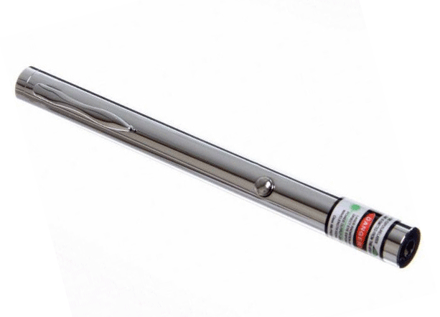
Laser light is shone on a wall. You can see a spot of light on the wall, but you can’t see anything between the pointer and the spot. Why?
You can only see light, if it goes into your eye.

Slide 4
How can the beam be made visible?
Light travels in straight lines, called rays.

Slide 5
How does a pinhole camera work?
Rays can be used to predict what images will form.

Slide 6
Grade 10 science also deals with the images formed by mirrors (curved and flat), by refraction at flat surfaces and the curved surfaces of lenses.
Why does it make sense to start with the images of pinhole cameras?

Slide 7
Part 2: The Wave Model of Light

Slide 8
Diffraction:
You have two pencils held together with elastics with a slight gap in between. You look through the vertical gap at a laser spot.
What will it look like as the gap is squeezed?
A) unchanged B) thinner C) wider D) it depends

Slide 9
Diffraction:
We usually don’t notice diffraction because light A) has very small wavelengths B) has very big wavelengths
C) travels very fast D) travels very slowly
Rays can be used to predict what images will form.

